Slide 1


Disaster Damage Assessment
Going Digital

Slide 2
Allegheny County Emergency Services
Five Divisions
911
Emergency Management
EMS
Fire Academy
Fire Marshals

Slide 3
Emergency Management
5 Emergency Managers on staff
Work in the 4 Phases of Emergency Management
Planning
Mitigation
Response
Recovery

Slide 4
Allegheny County by the Numbers
1.32 Million Residents
3 Presidentially Declared disasters last 10 years
3 assessed disasters in 2016

Slide 5
Challenge 1: Pen & Paper
Forms filled out with pen and paper
2 Assessment Forms Identical information
Consolidation Document filled by hand

Slide 6
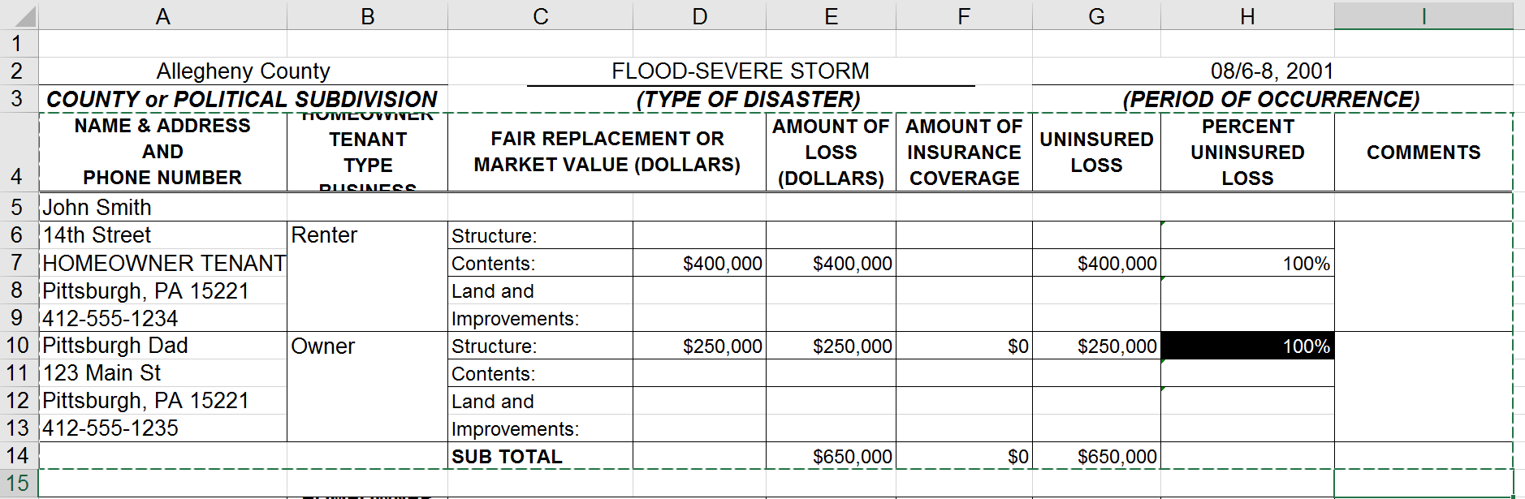
Challenge 2: The Consolidation Form

Slide 7
Challenge 2: The Consolidation Form
How to Auto Populate the Consolidation Form?

Slide 8
Impact: Digital Content Key to
Streamlining Financial Aid
To PEMA
To FEMA
SBA Loan
Form
Consolidation
Document
Consolidation
Document
Disaster Damage
County
Assessment
Federal
Assessment
Consolidation
Document
To PEMA
To FEMA
Individual Assistance
Form
Consolidation
Document

Slide 9
Challenge 3: Using Data to Streamline the Number of Forms Required
PEMA
Auto Populated
Consolidation Form
County Assessment
Fillable Form Populates Both Assessment Documents
FEMA

Slide 10
Users
County EMA Staff
Local EMA Volunteers
Emergency Management Coordinators
PEMA
FEMA

Slide 11
Data
Data points=Fillable Boxes & Drop Downs
Static Questions
Sensitive Information
Must be shareable:
County
PEMA
FEMA

Slide 12
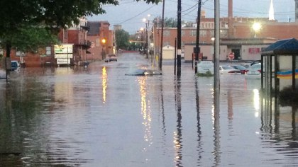
xx%
Millvale
Disasters can strike when we least expect it.

